Slide 1

Project
House Price Prediction
Suyash Maurya
A23046

Slide 2
OUTLINE
Introduction
Problem Statement
Project Specification
Dataset
Data Cleaning
EDA
Outlier Detection
Outlier Removal
Algorithms
Pipeline
Result
Conclusion

Slide 3
INDRODUCTION
In the course of this project, we have developed a machine learning model designed to forecast the prices of houses within a given city. The implications of this endeavor extend significantly to the real estate sector, proving beneficial for both those looking to sell their homes and potential buyers. Leveraging the Multiple Regression algorithm, we have successfully crafted a model that achieves an impressive accuracy score.

Slide 4
PROBLEM STATEMENT
The intricate connection between real estate prices and our economy underscores the complexity of this relationship. Despite the wealth of available data, obtaining precise measures of house prices remains a challenge. Establishing fair and well-founded property valuations holds the potential to reintroduce transparency and trust into the real estate sector, a critical factor for consumers, particularly in the context of India.

Slide 5
PROJECT SPECIFICATION
This project aims to forecast the prices of houses within a city by considering various features like location, size/area, number of bedrooms, and number of bathrooms.
The model is constructed using a dataset specific to city house prices, and the predictive capabilities are harnessed through the application of a Machine Learning Algorithm.
The implementation involves the utilization of the Multiple Regression algorithm for training and testing the model.

Slide 6
DATA SET
Our dataset, sourced from secondary data, comprises 1460 observations.
It encompasses a total of 81 columns or attributes, providing detailed information on elements such as street, lot area, house style, electrical systems, central air presence, sale type, sale condition, and various other parameters.

Slide 7
DATA CLEANING
The primary objective of Data Cleaning is to detect and eliminate errors and duplicate entries, thereby ensuring the establishment of a dependable dataset. During the data cleaning process.
I conducted an assessment for missing values in the dataset. Subsequently, I identified three numerical columns containing missing values.
To address this, I calculated the means for these columns and replaced the missing values accordingly. It is noteworthy that no missing values were observed in the categorical columns.

Slide 8
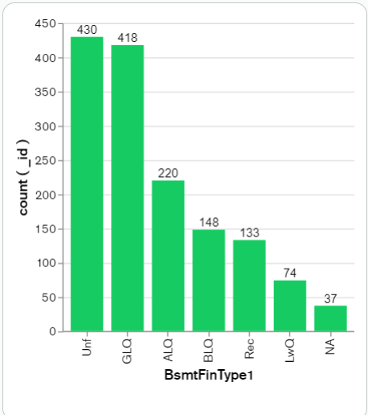
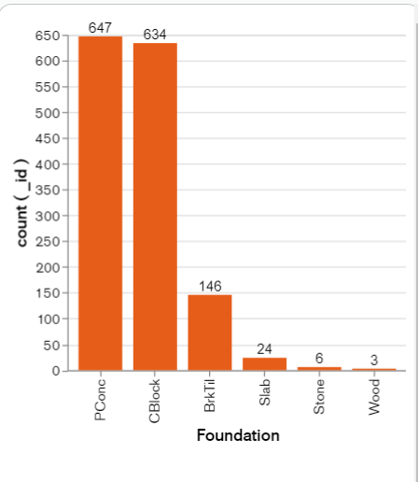
EDA

Slide 9
OUTLIER DETECTION
In simpler terms, an outlier is an observation that deviates from the typical pattern within a sample. Various techniques, such as Z-Score, Extreme Value Analysis, Probabilistic and Statistical Modeling, Information Theory Models, and Standard Deviation, are employed for outlier detection.
In the context of my project, the Interquartile Range (IQR) method has been applied. The identification of outliers in our dataset is facilitated by incorporating basic domain knowledge related to the real estate market.

Slide 10
OUTLIER REMOVAL
Implement “replce_outlier_up2” to replace outliers on the upper side of a specified numerical column with a given value.
Implement “replce_outlier_low2” to replace outliers on the lower side of a specified numerical column with a given value.

Slide 11
ALGORITHMS
This project focuses on evaluating and comparing the performance of Decision Trees, Random Forest, and Gradient Boosting algorithms to determine the most effective approach for predictive modeling.
Base Learner:
Decision Tree Utilized Decision Tree as the foundational algorithm for establishing a baseline predictive model.
Ensemble Techniques:
Random Forest and Gradient Boosting Implemented Random Forest and Gradient Boosting as ensemble techniques to explore their potential for improving predictive accuracy.

Slide 12
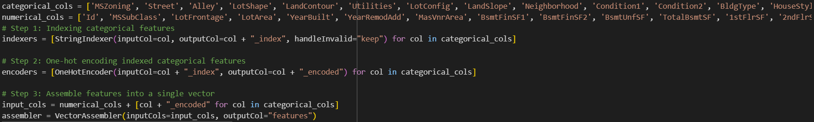
PIPELINE
INDEXING
ONE HOT CODING
ASSEMBLING
MODELLING
RESULT
.

Slide 13


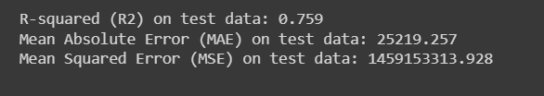
RESULT
DICISION TREE
RANDOM FOREST
GRADIENT BOOSTING

Slide 14



Result with Hyperparameter Tunning
DICISION TREE
RANDOM FOREST
GRADIENT BOOSTING

Slide 15
CONCLUSION
I Found that among the considered algorithms, if i conclude result on basis of R-Square Random Forest demonstrated the best performance in terms of predictive accuracy.
This project contributes to the understanding of the strengths and weaknesses of different tree-based algorithms, emphasizing the superior performance of Random Forest in the specific predictive modeling context. The findings can guide future applications and research in data-driven decision-making.

